Slide 1
Group Four Presents
Project Curio
Minimal Distraction-Free Blogging Webapp to Share Your Story, Thought and Adventure Log.
CSE 356
Software Engineering & System Analysis Lab

Slide 2
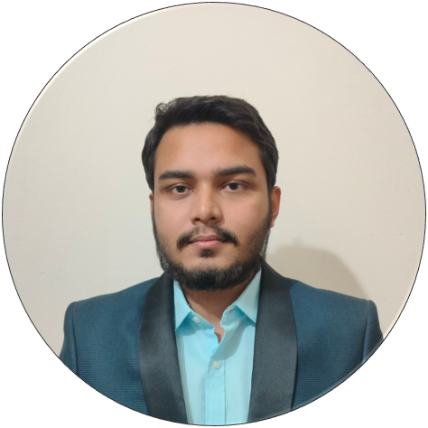
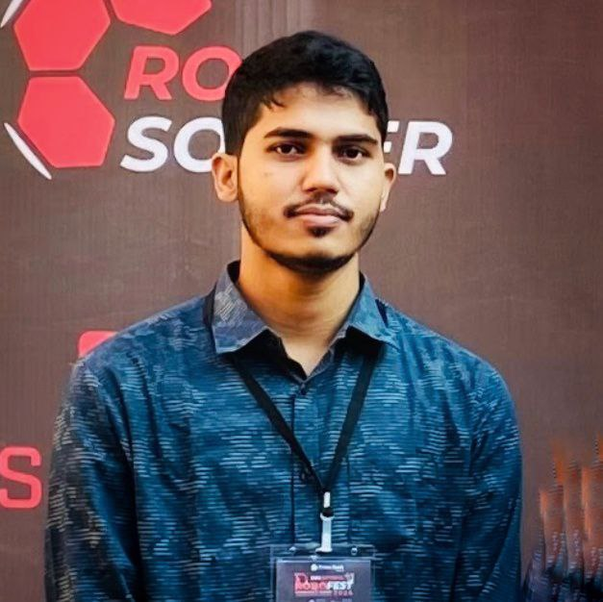
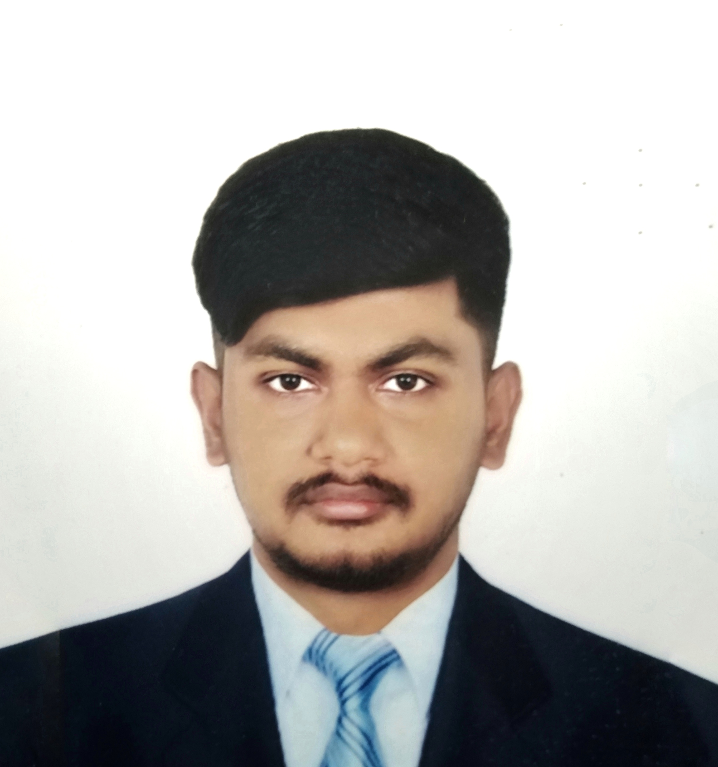

Presented By:
Md. Shakibul Hasan Sakib
ID: 2215151115
Zobayer Hasan
ID: 2215151106
Tanveer Ahammed Tarek
ID: 2215151109

Slide 3
Presented To:
Engineer Md. Safaet Hossain
Associate Professor,
Department of CSE,UITS.
Propa Punam
Lecturer,
Department of CSE,UITS.

Slide 4
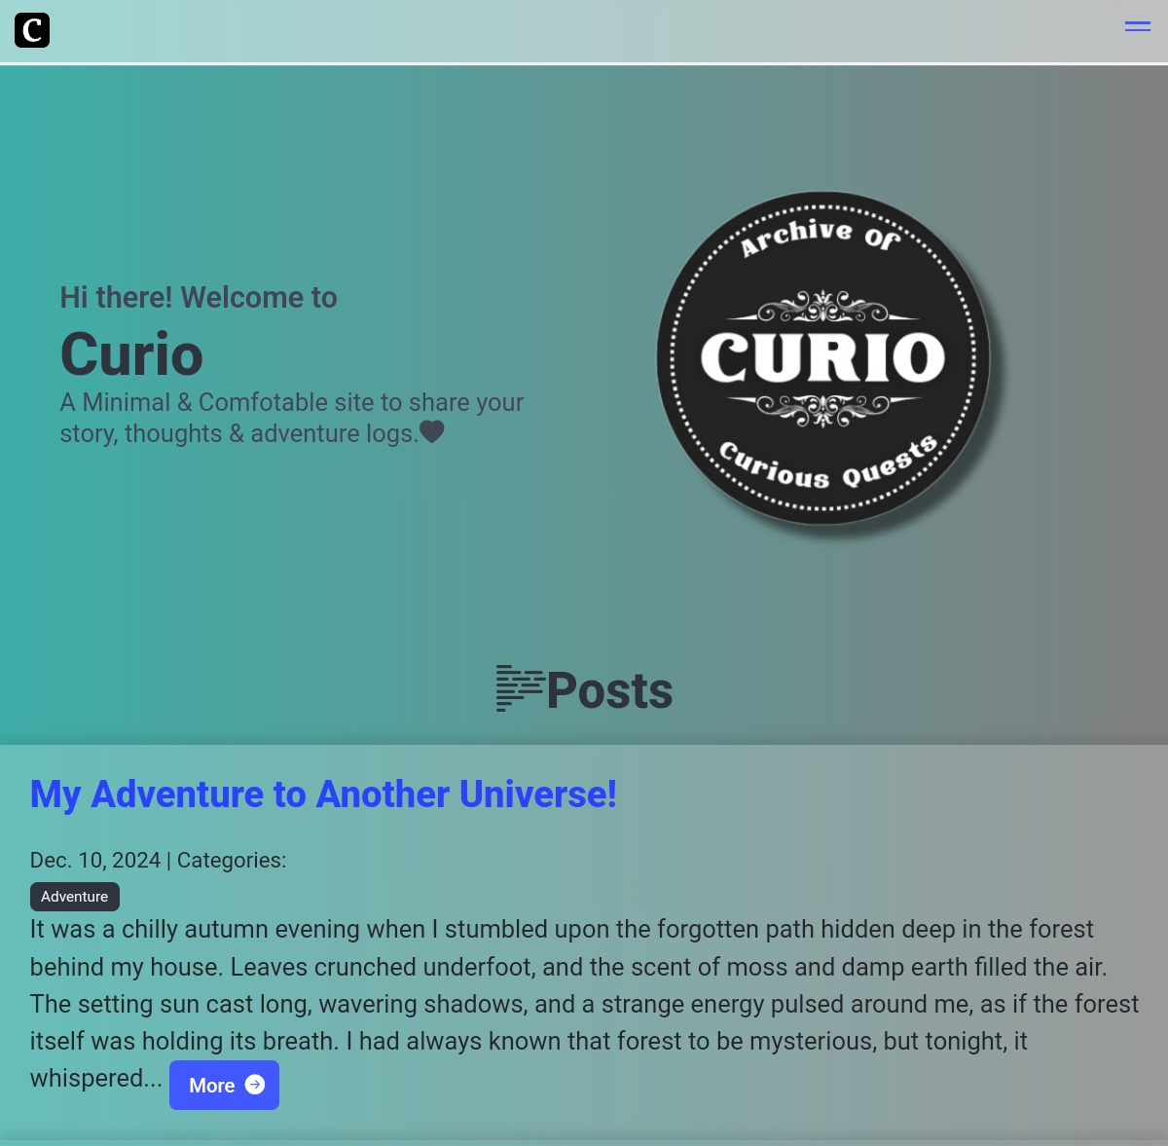
Agenda
Introduction ……………………....1
Software Requirements- Specification (Key Features) …...2
Software Analysis & Modeling ...4
Gantt Chart & Budget Sheet …..15
Project Overview ………………..19

Slide 5
Introduction
1
Blogging platforms today often overwhelm users with complex interfaces and features that aren’t necessary for readers and writers. These distractions can hinder creativity and productivity. This project addresses this problem by offering a clean, distraction-free blogging experience. Built using Django, it focuses on content creation and reading while minimizing external interruptions like pop-ups, and unnecessary notifications.

Slide 6

Software Requirements Specification (Key Features)
2

Slide 7
3
What We Wanted To Achieve
Minimal and Distraction-Free
Simple but Gorgeous
User Friendly but Secure
Productive but Fun too
All the Feature you Need
Power and Stability of Django
Bridges the gap between Simplicity and Functionality
Aims Towards who desires awesome blogging experience with all above

Slide 8
4
System Analysis & Modeling

Slide 9
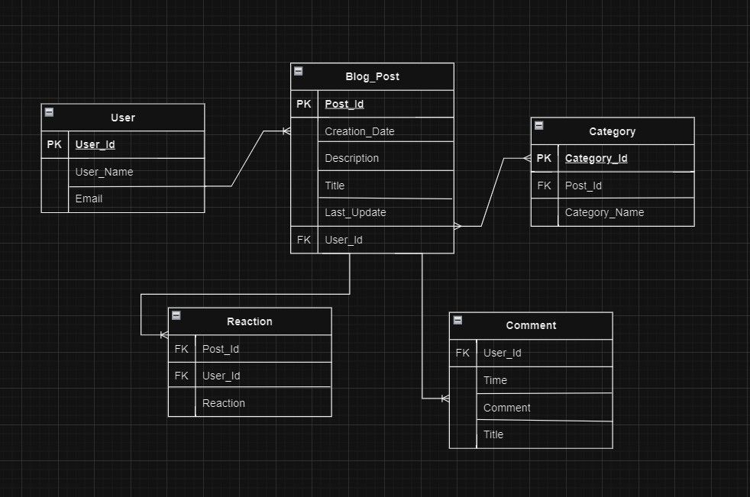
ER Diagram
5

Slide 10
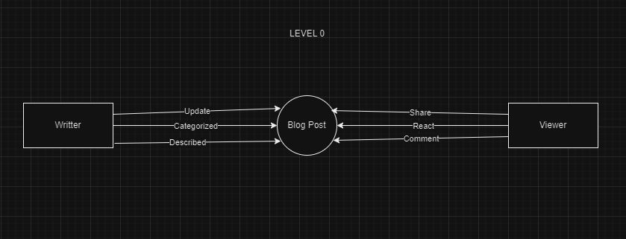
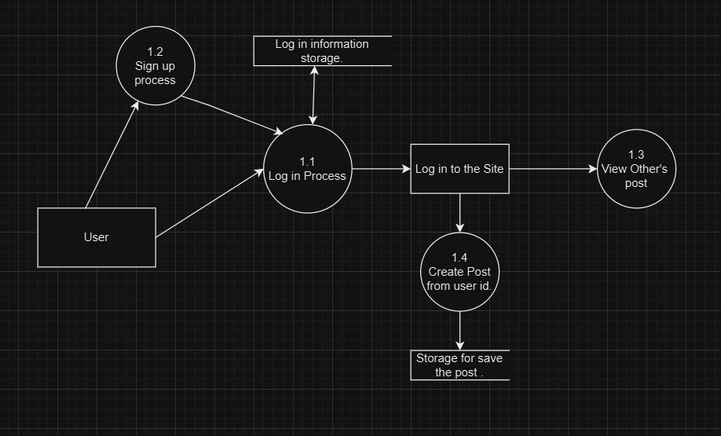
Data Flow Diagrams
6
DFD Level-0
DFD Level-1

Slide 11
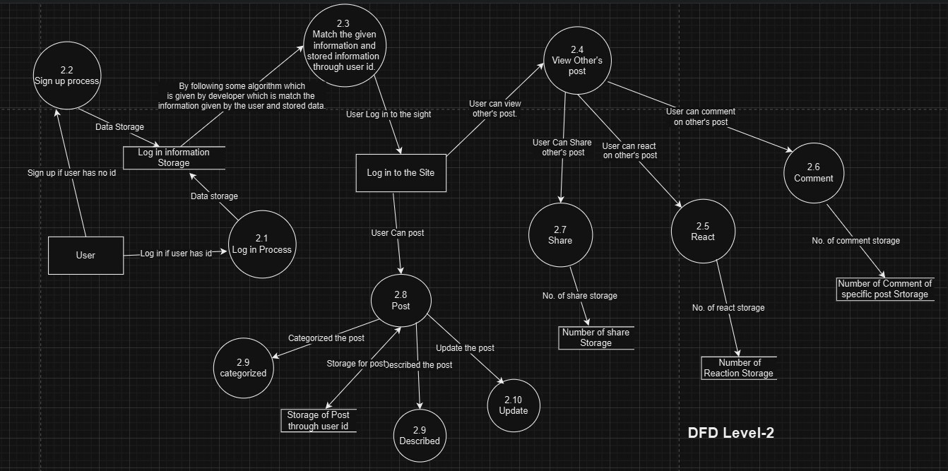
Data Flow Diagrams
7
DFD Level-2

Slide 12
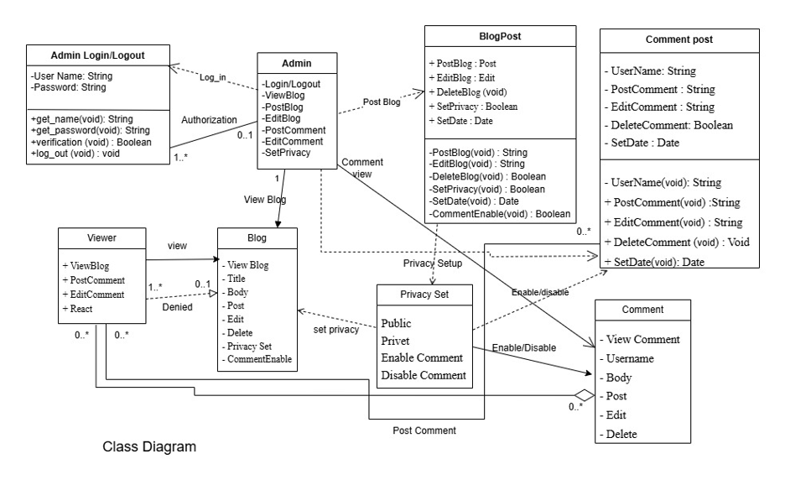
Class Diagram
8

Slide 13
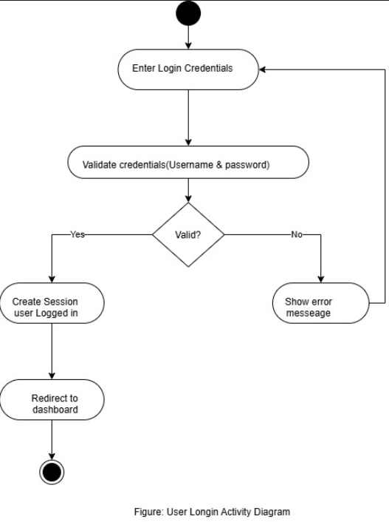
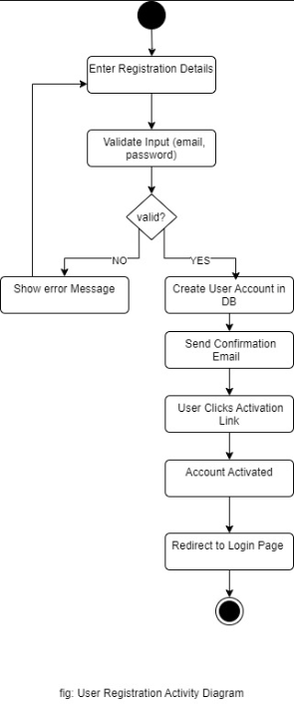
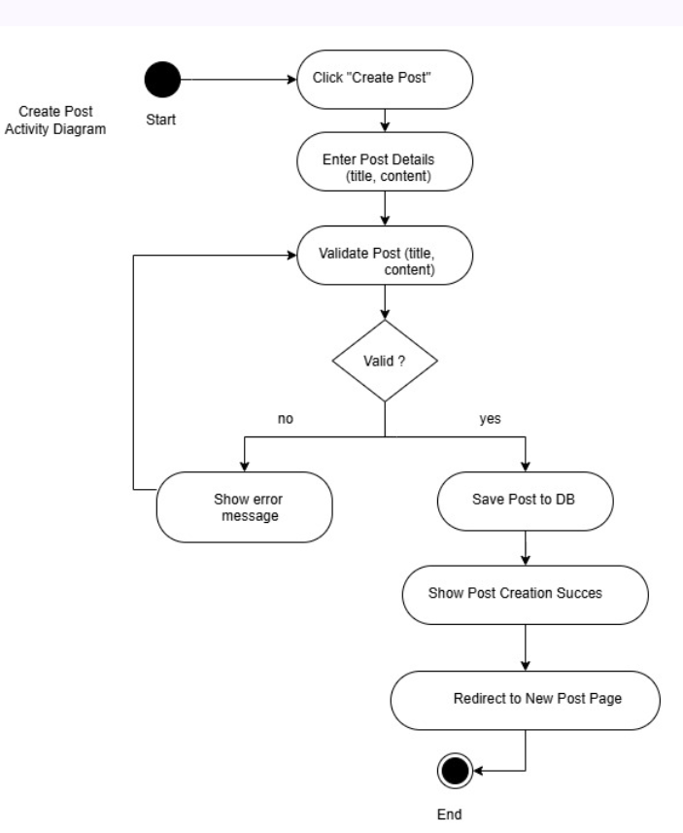
Activity Diagrams
9

Slide 14
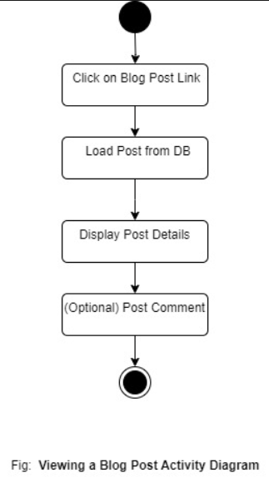
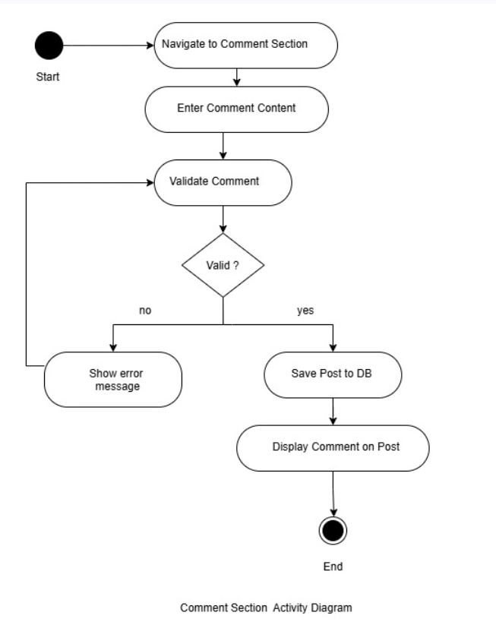
Activity Diagrams
10

Slide 15
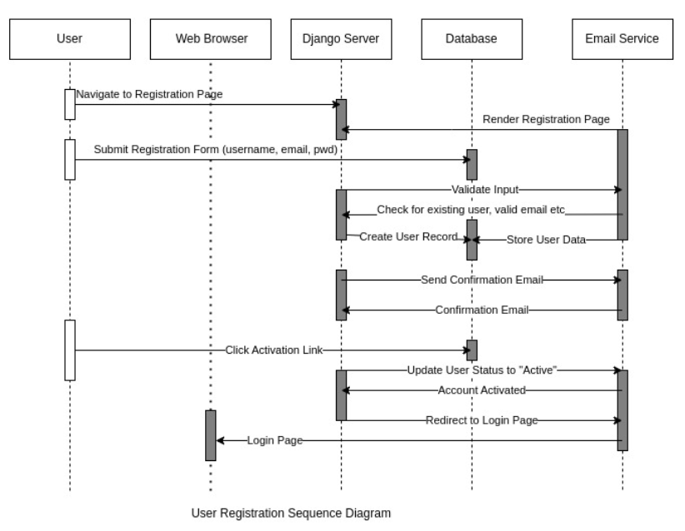
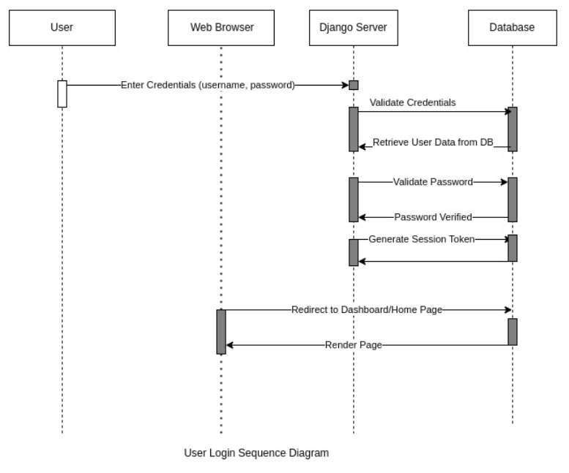
Sequence Diagrams
11

Slide 16
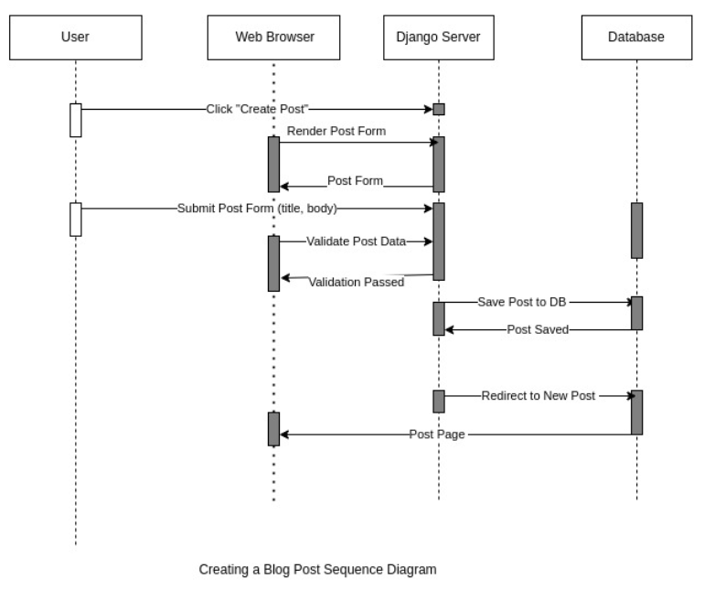
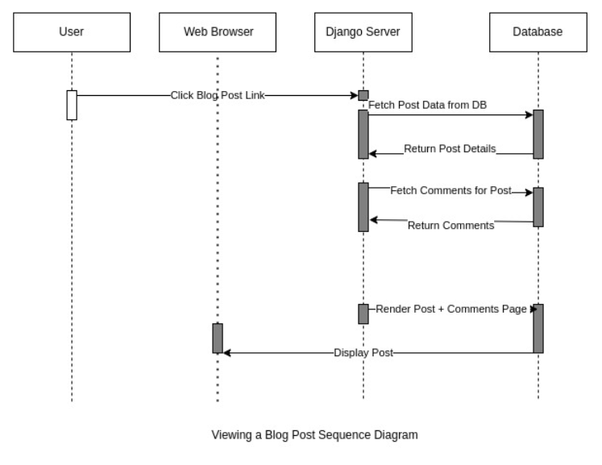
Sequence Diagrams
12

Slide 17
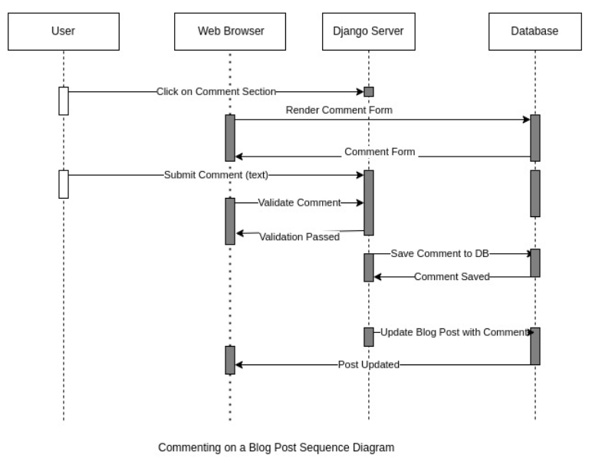
Sequence Diagrams
13

Slide 18
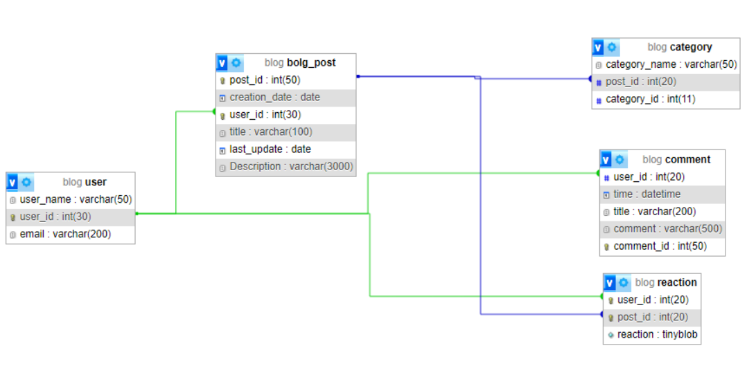
Database Relationship
14

Slide 19
15
Gantt Chart
Budget Sheet

Slide 20
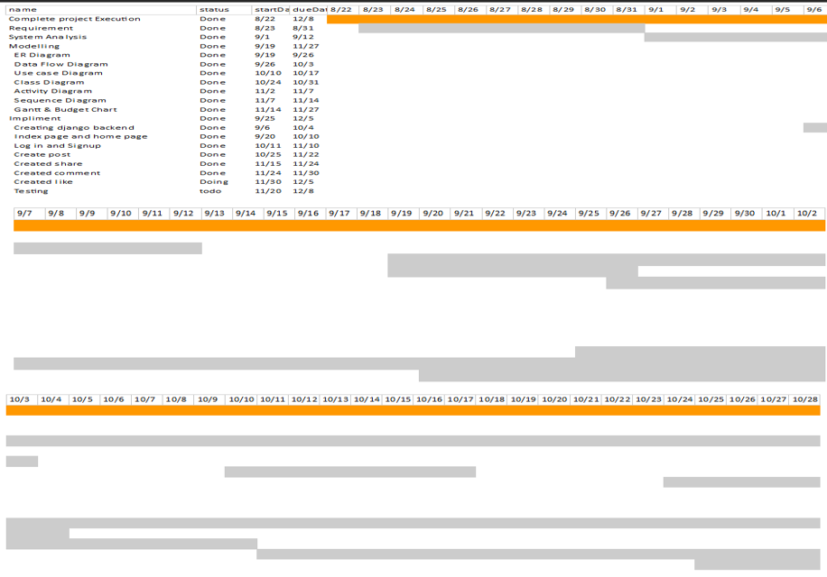
Gantt Chart
16

Slide 21
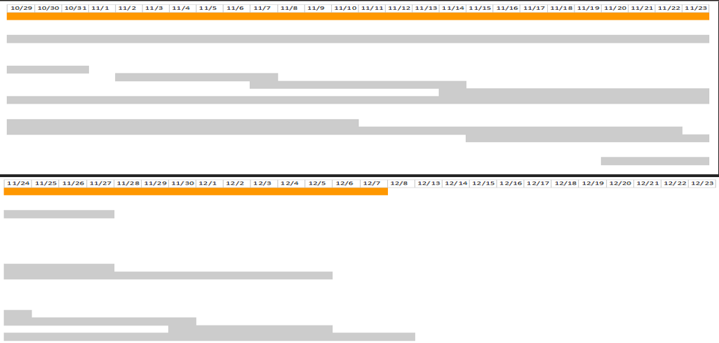
Gantt Chart
17

Slide 22
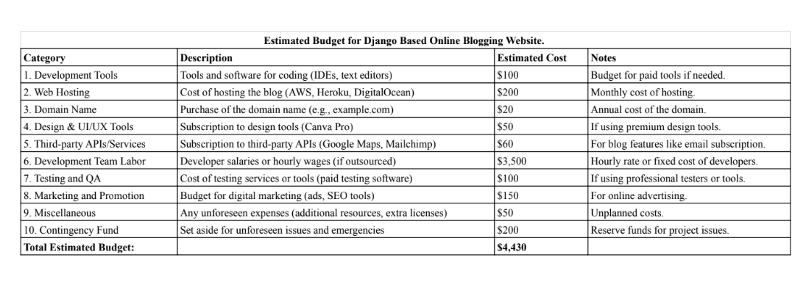
Budget Sheet
18

Slide 23
19
Project Overview(Screenshots)

Slide 24
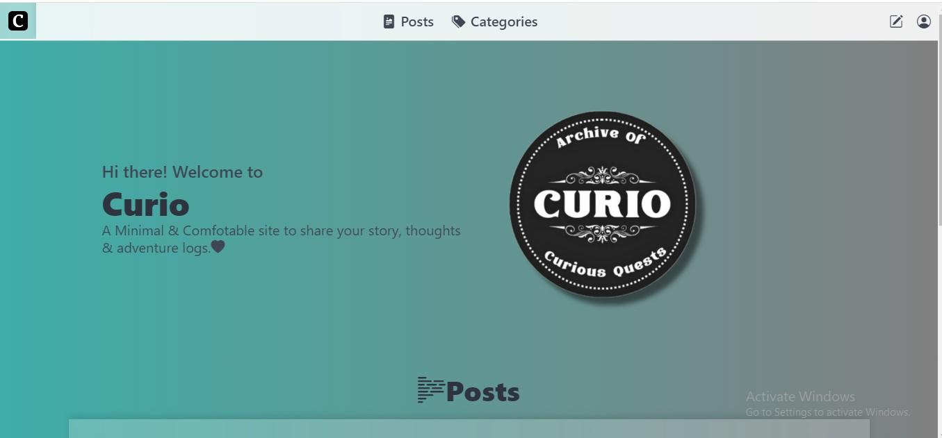
Project Screenshot
20

Slide 25
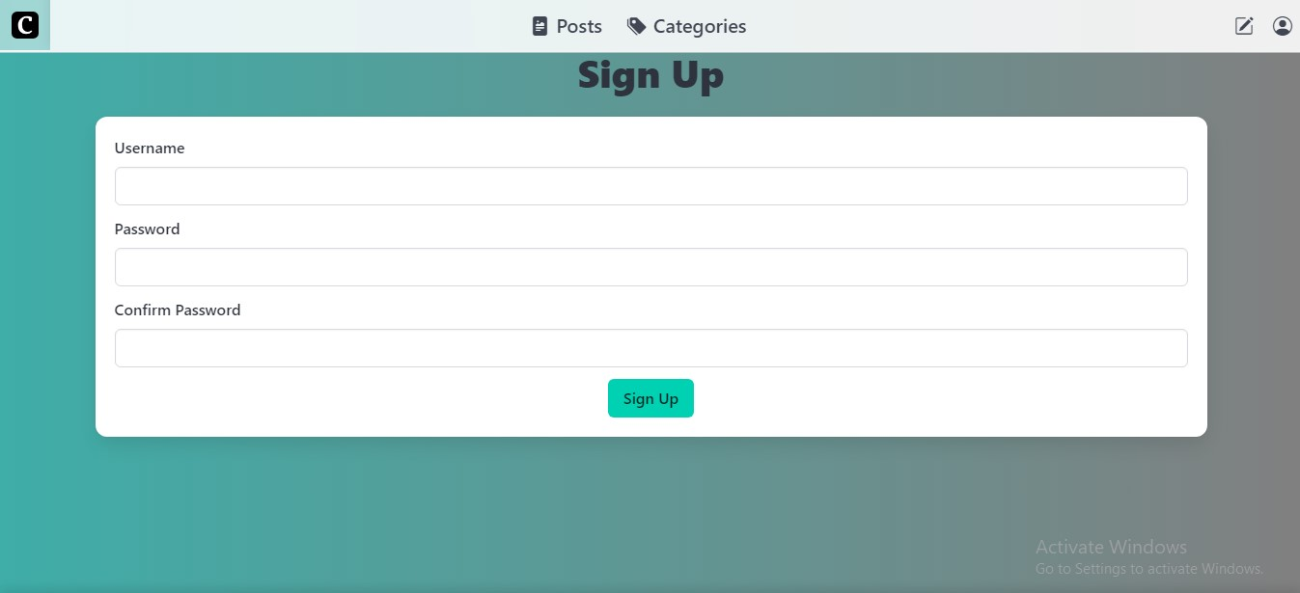
Project Screenshot
21

Slide 26
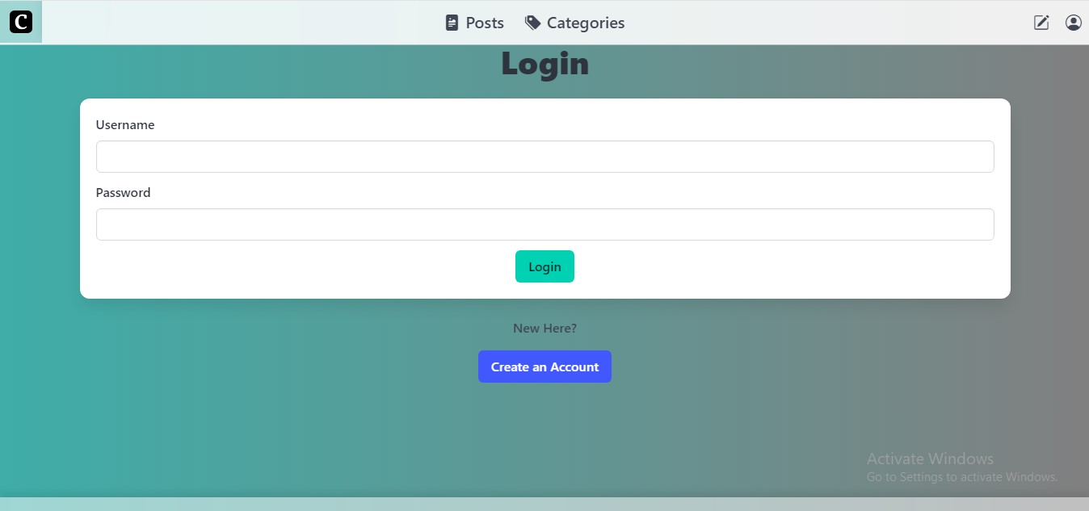
Project Screenshot
22

Slide 27
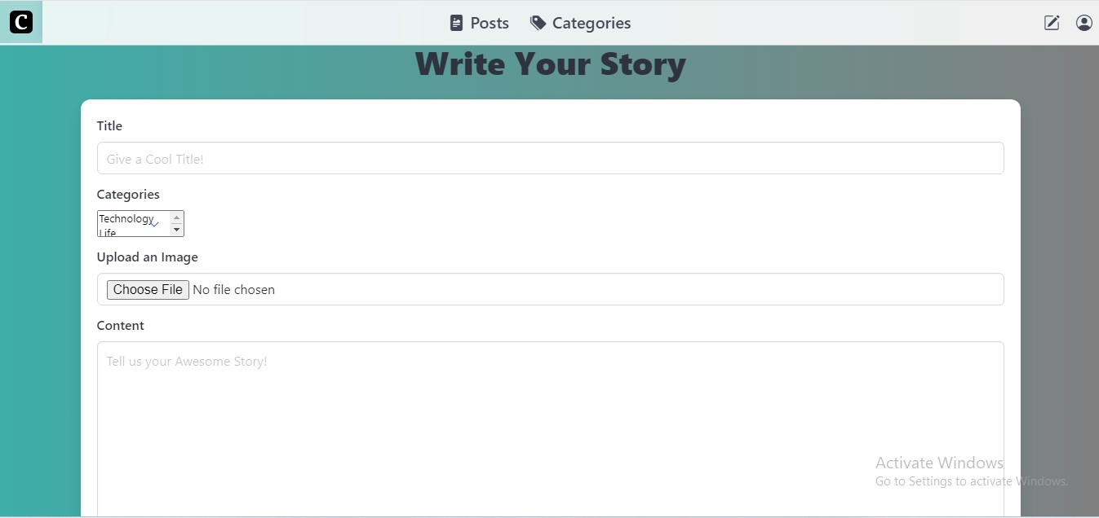
Project Screenshot
23

Slide 28
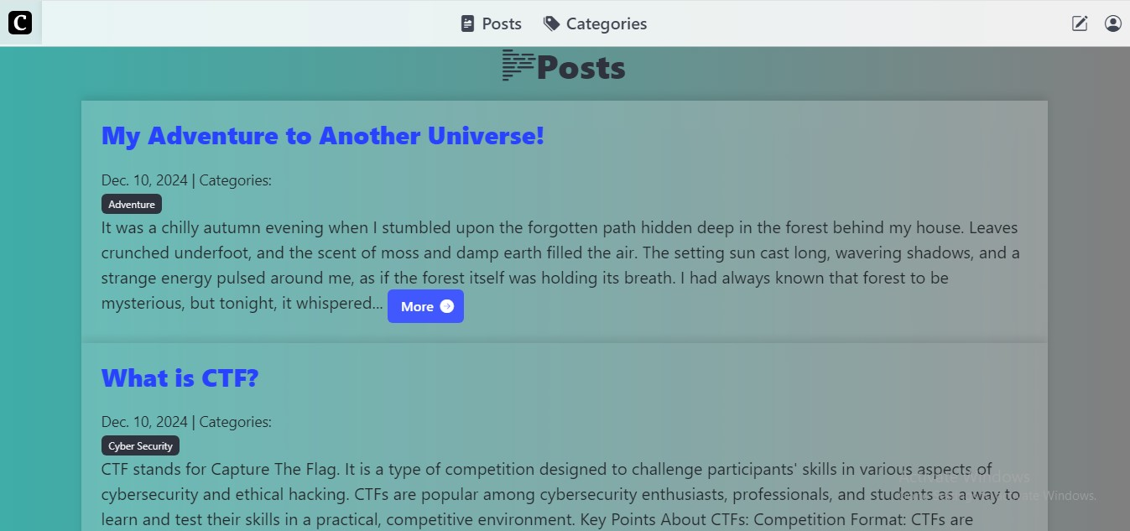
Project Screenshot
24

Slide 29
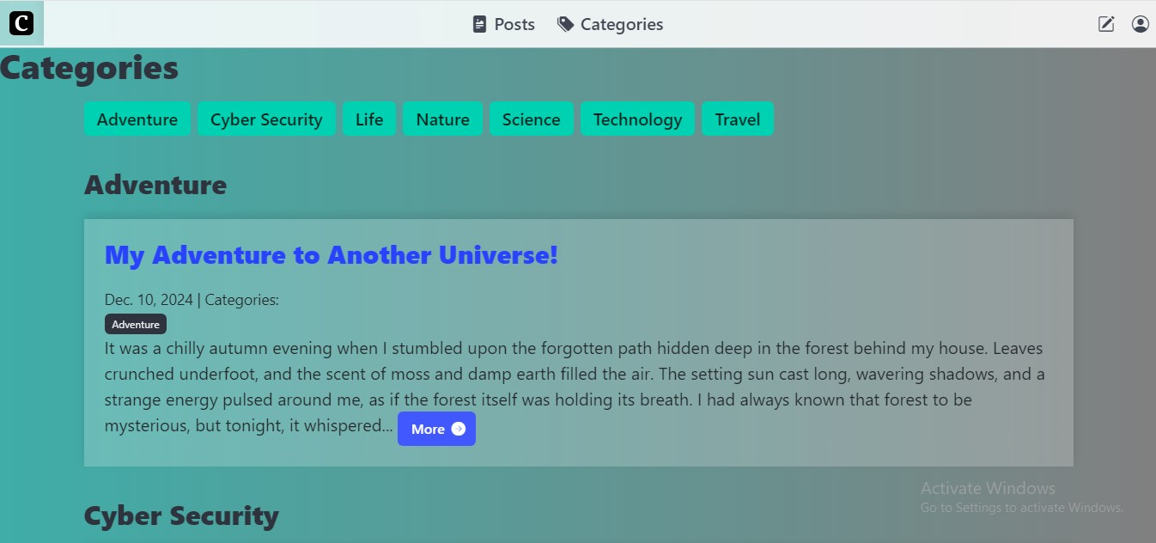
Project Screenshot
25

Slide 30
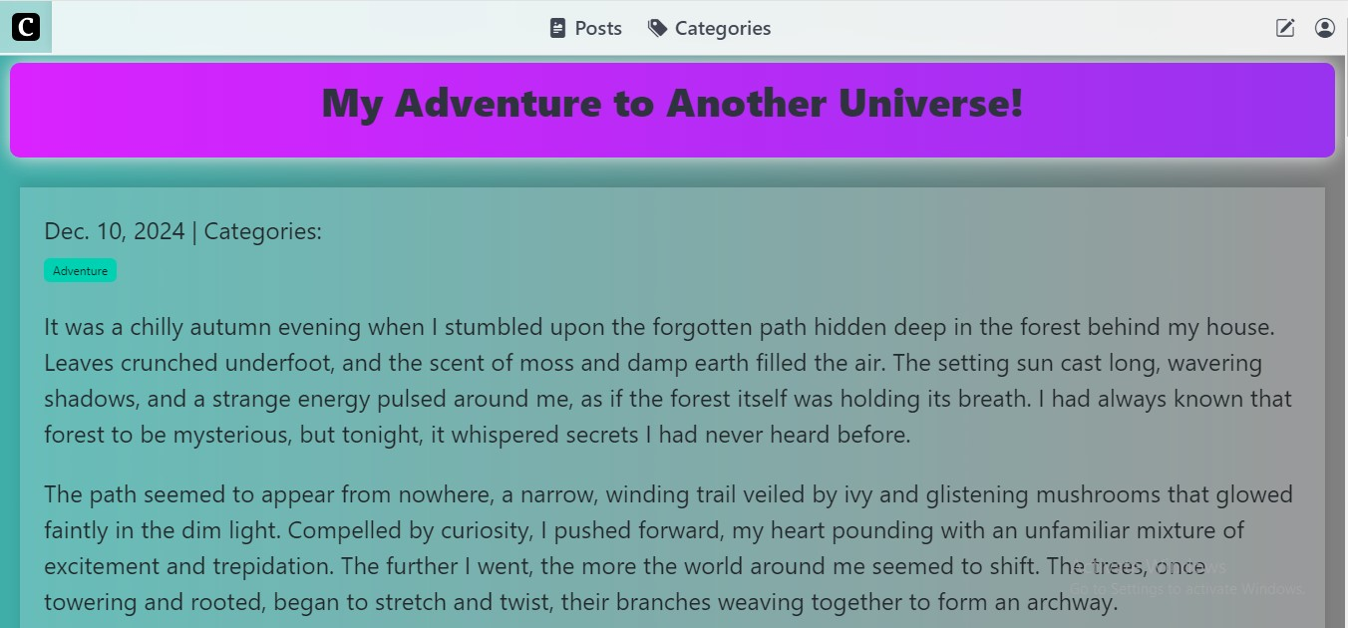
Project Screenshot
26

Slide 31
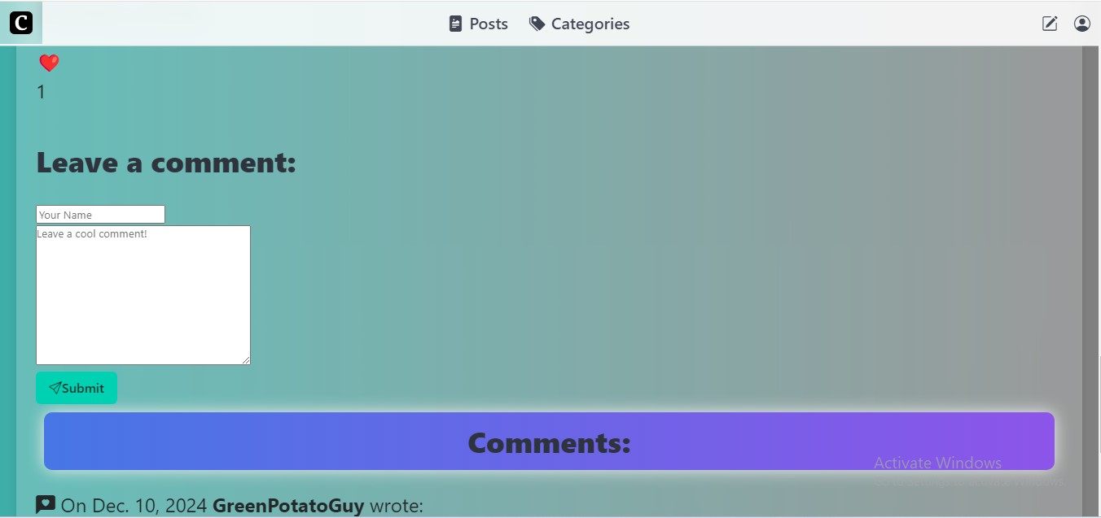
Project Screenshot
27

Slide 32
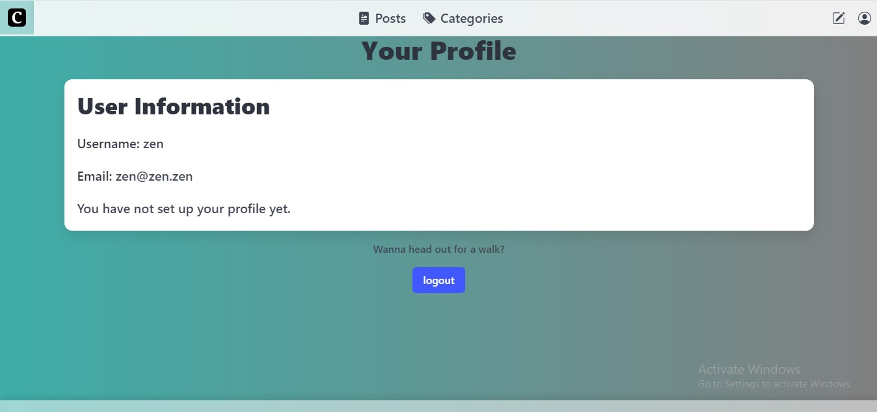
Project Screenshot
28

Slide 33

Questions?
29

Slide 34

Thank you

